Slide 1
Recitation 4
10/1/21
Greg, Will, Lili

Slide 2
Downloading arduino for the Oscillosorta

Slide 3
Intro to prototyping - laser cutting

Slide 4
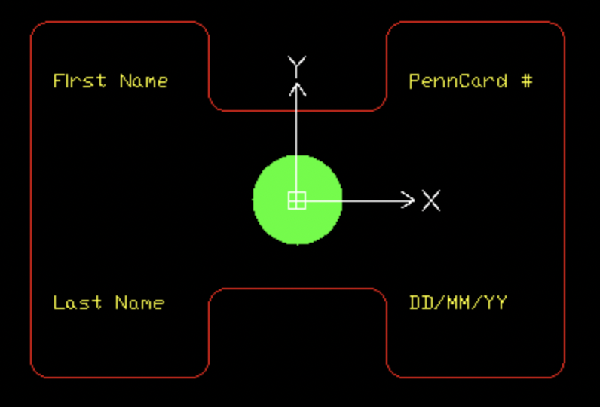
What you need to be RPL trained!
Step One – Watch and Learn
Step Two – Prepare
Step Three – TAKE THE QUIZ
Step Four – RPL Time
Step Five – Swipe Access
(takes 1-2 weeks, plan accordingly)
https://meamlabs.seas.upenn.edu/rapid-prototyping-lab/training/

Slide 5
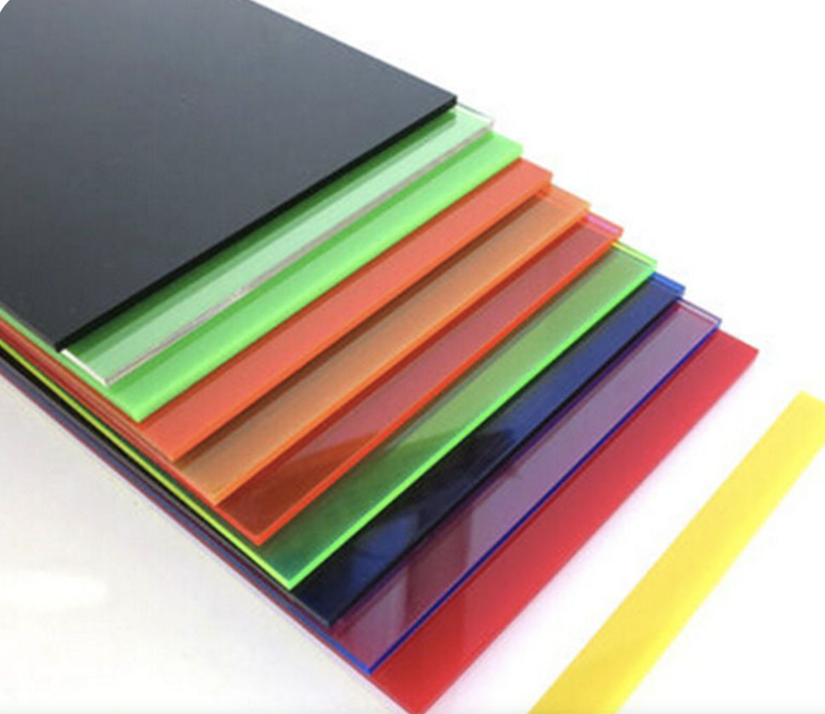

RPL Materials - Acrylic and MDF
Acrylic
¼ inch (black, white, clear, and smoke)
⅛ inch (black, white, clear, smoke, red, yellow, green, and blue
MDF
¼ inch
⅛ inch

Slide 6
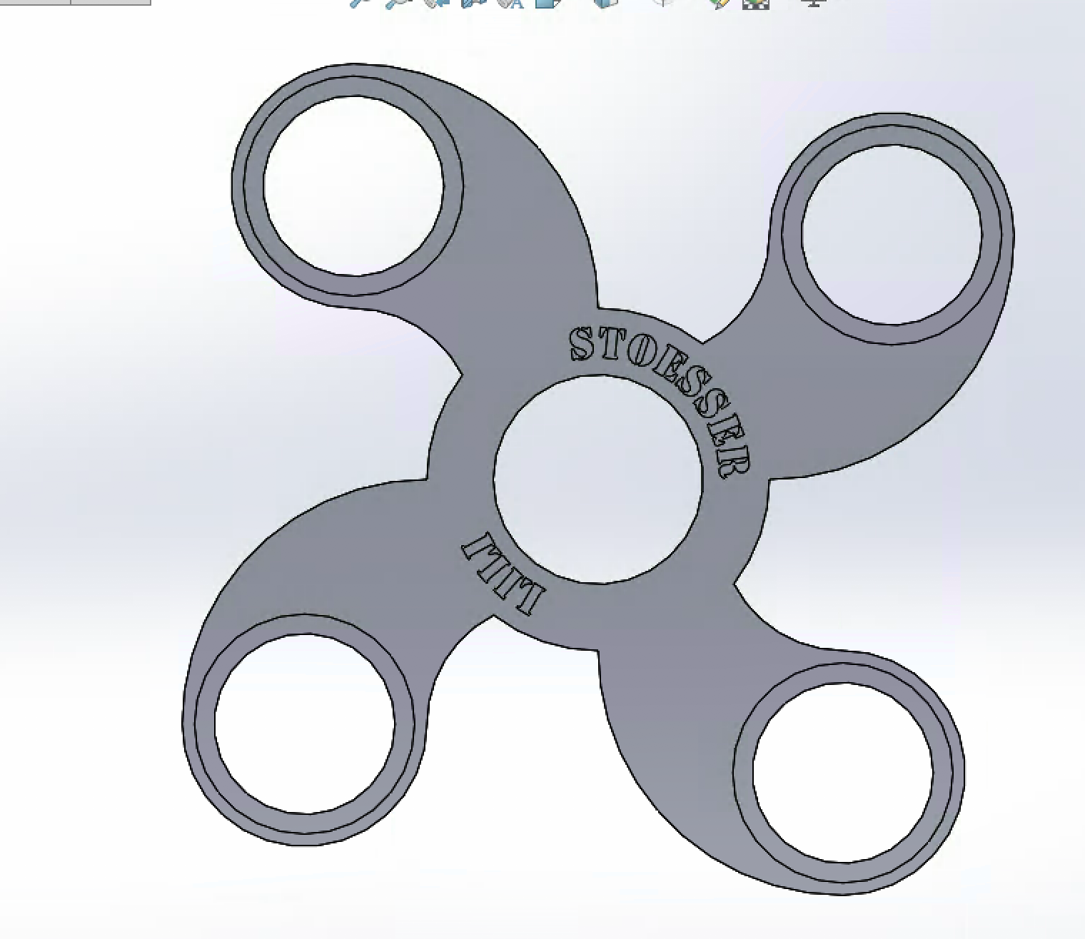
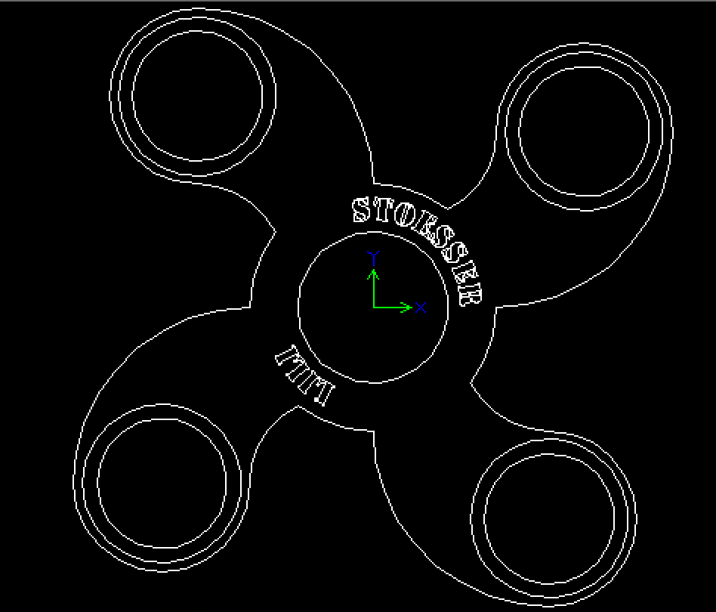
Saving as a .dwg
File -> save as -> change file type to .dwg

Slide 7
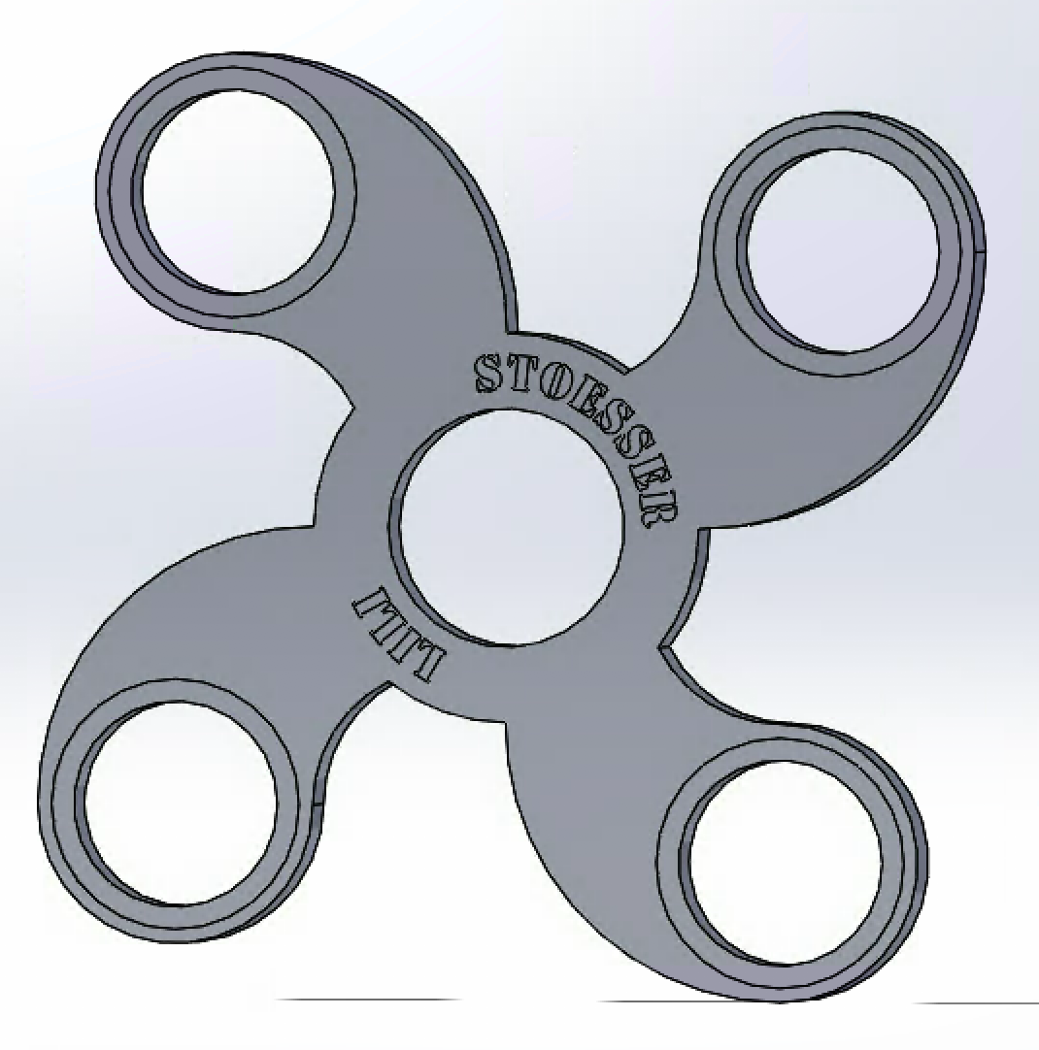
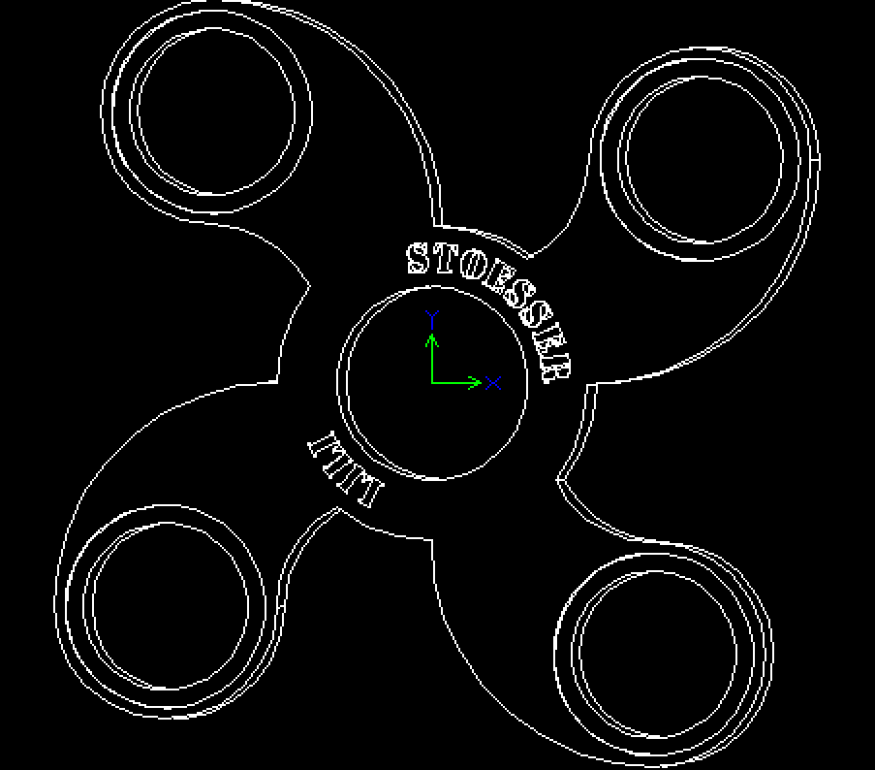
Bad!
click control + 8 to snap to a front view

Slide 8
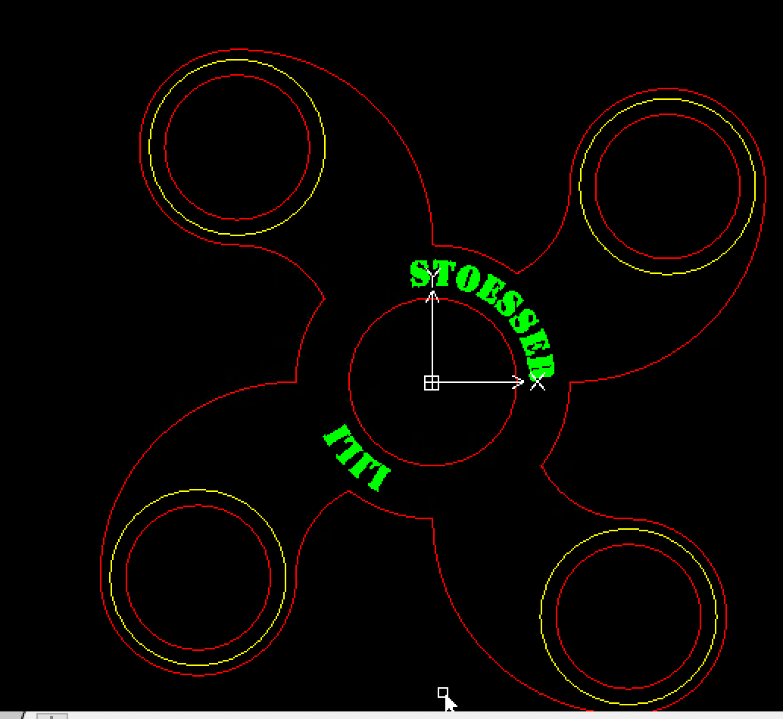
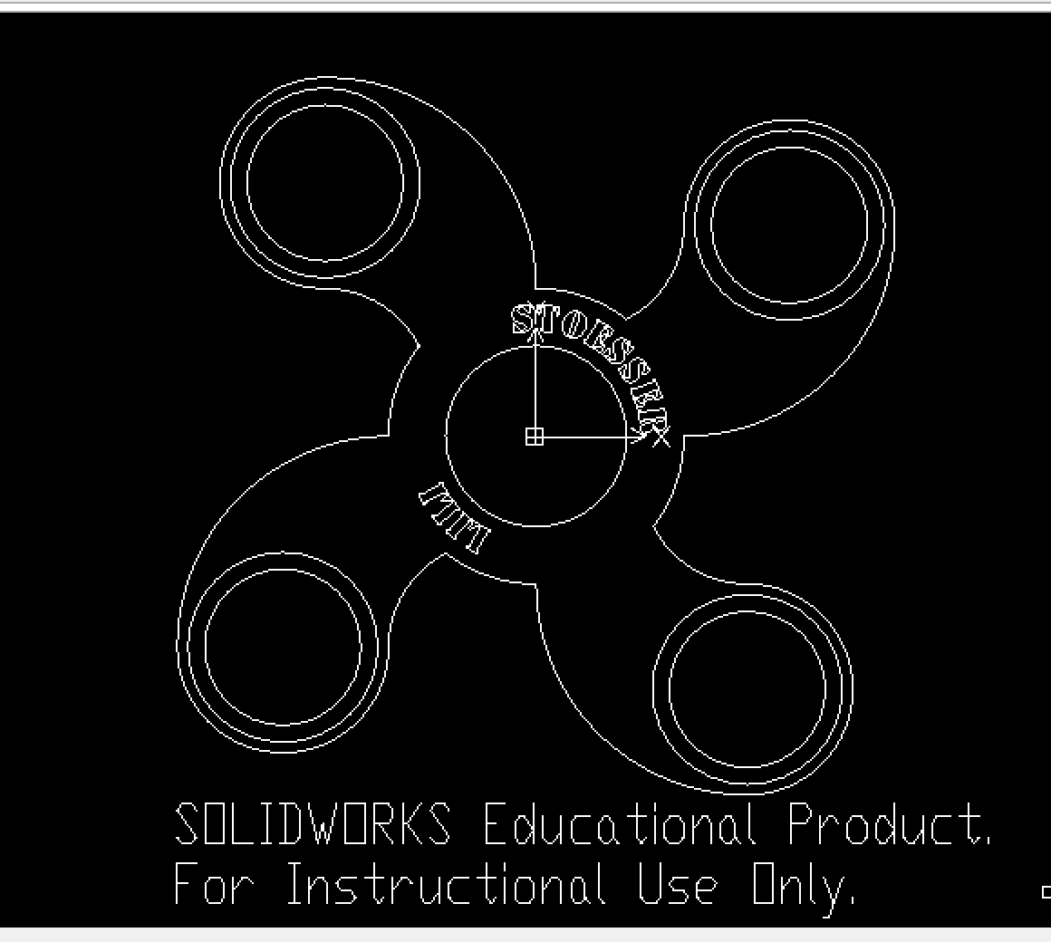
Open .dwg in DraftSight
DraftSight and Solidworks are available on the virtual PC lab
Delete “Solidworks Educational Product…”
Highlight ALL lines and set line width to 0.05mm
Change line colors
To cut all of the way through make lines red
Make vector etched lines yellow
To raster etch use the “hatch tool” and set the pattern to solid. Then make your filled in features green
Notes:
INITIALIZE EVERY PART

Slide 9
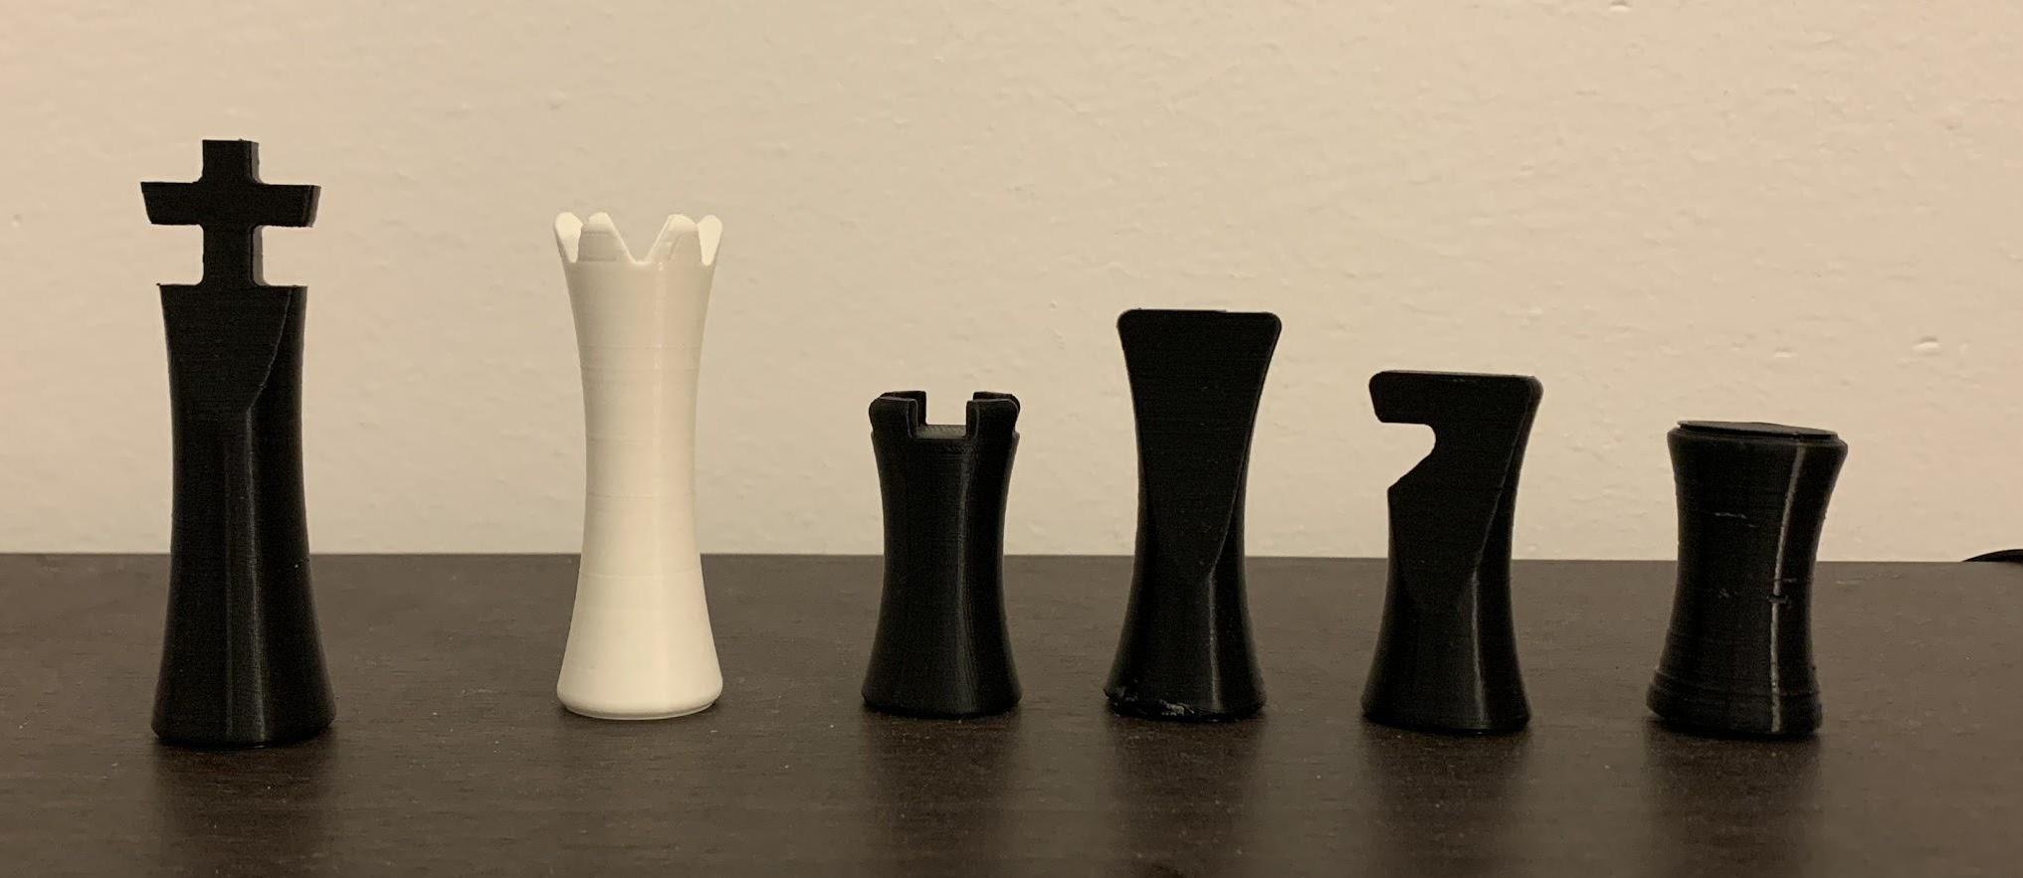
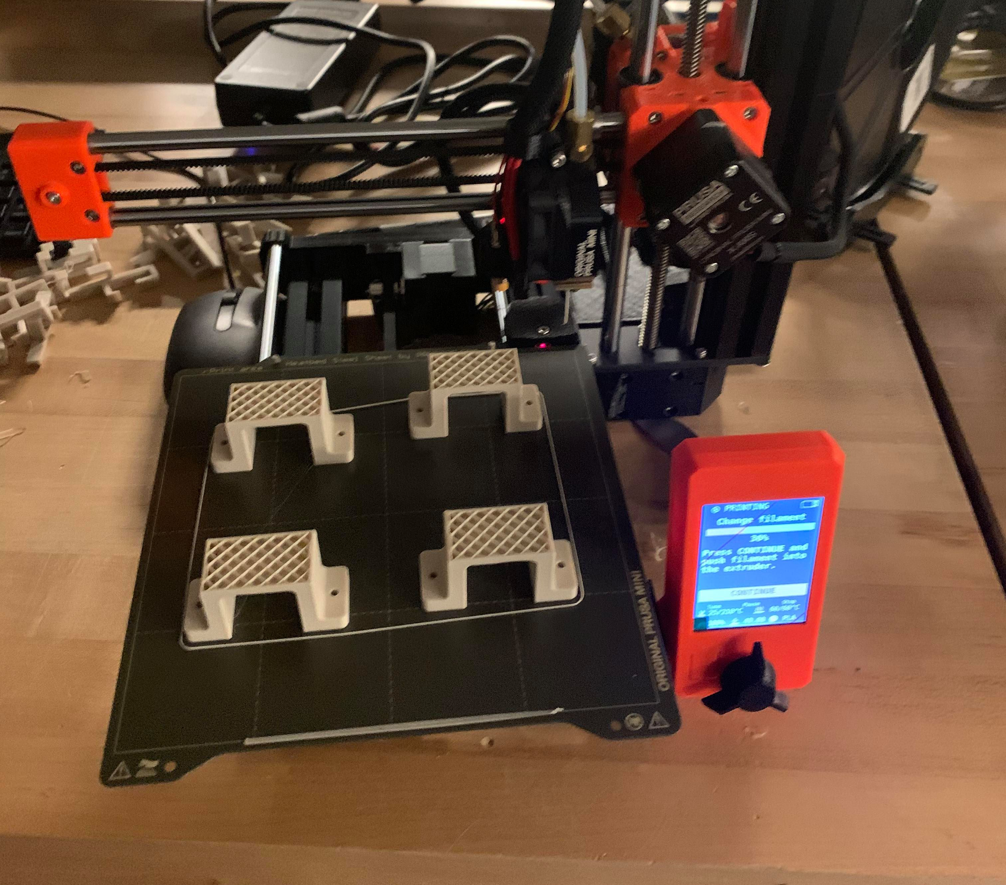
3D printing
RPL Printers (Lulzbot mini 2)
PLA
Preparing files
Save as .STL
Open your STL in CuraLULZBOT
Make sure your part is flat on the bed
Save as .gcode
Notes:
SUBMIT SLDPART ONLY

Slide 10
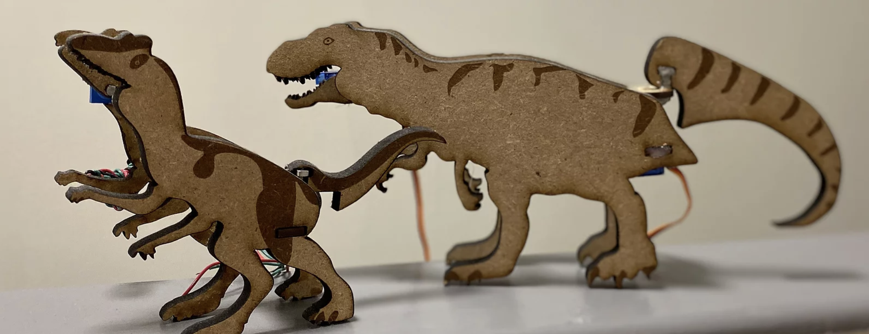
Tips!
Make a Solidworks assembly BEFORE you cut/print anything
MDF is easier to press fit (acrylic is more likely to snap)
Be creative!

Slide 11
Taking Care of the RPL
HOW I LEARNED TO STOP LEAVING A MESS AND LOVE THE SPACE - Tony Qiu

Slide 12
Taking Care of the RPL The RPL and You
HOW I LEARNED TO STOP LEAVING A MESS AND LOVE THE SPACE - Tony Qiu

Slide 13
Why?
The RPL is a small shared community space
Mechatronics is the biggest group using it
Clean workplaces are nice

Slide 14
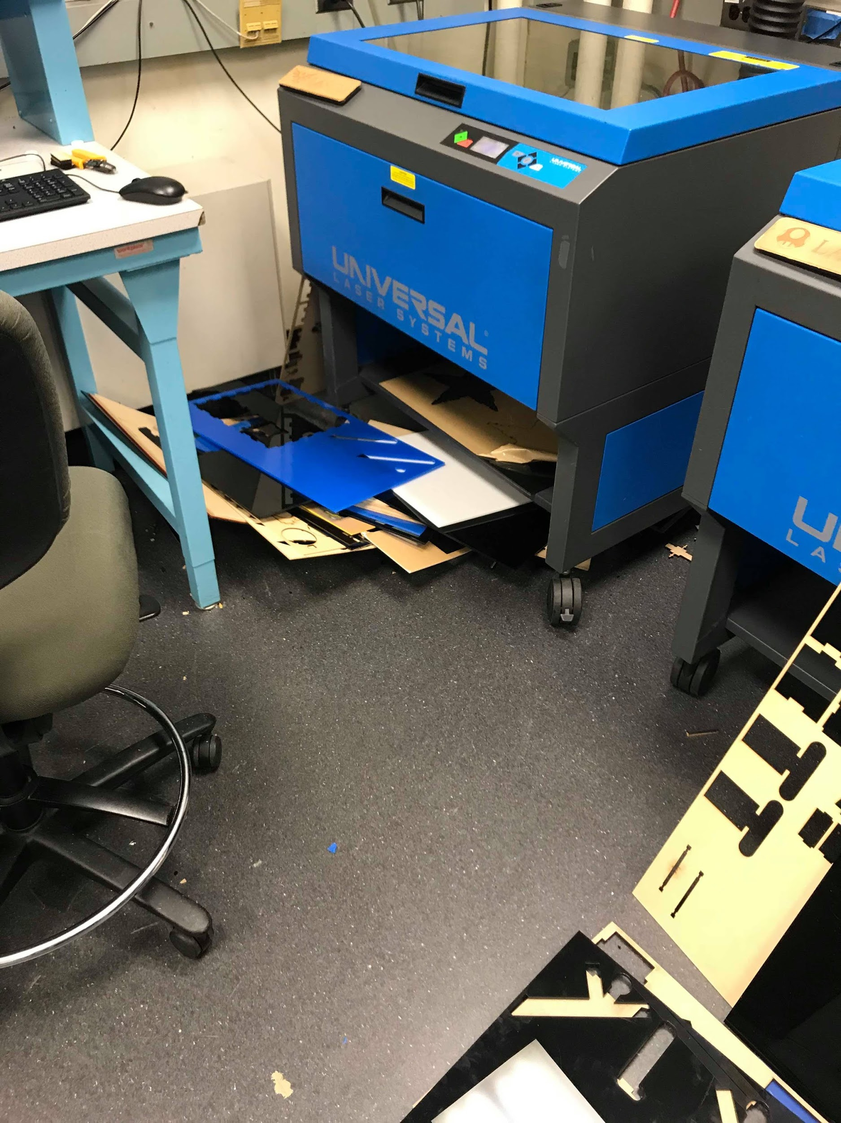
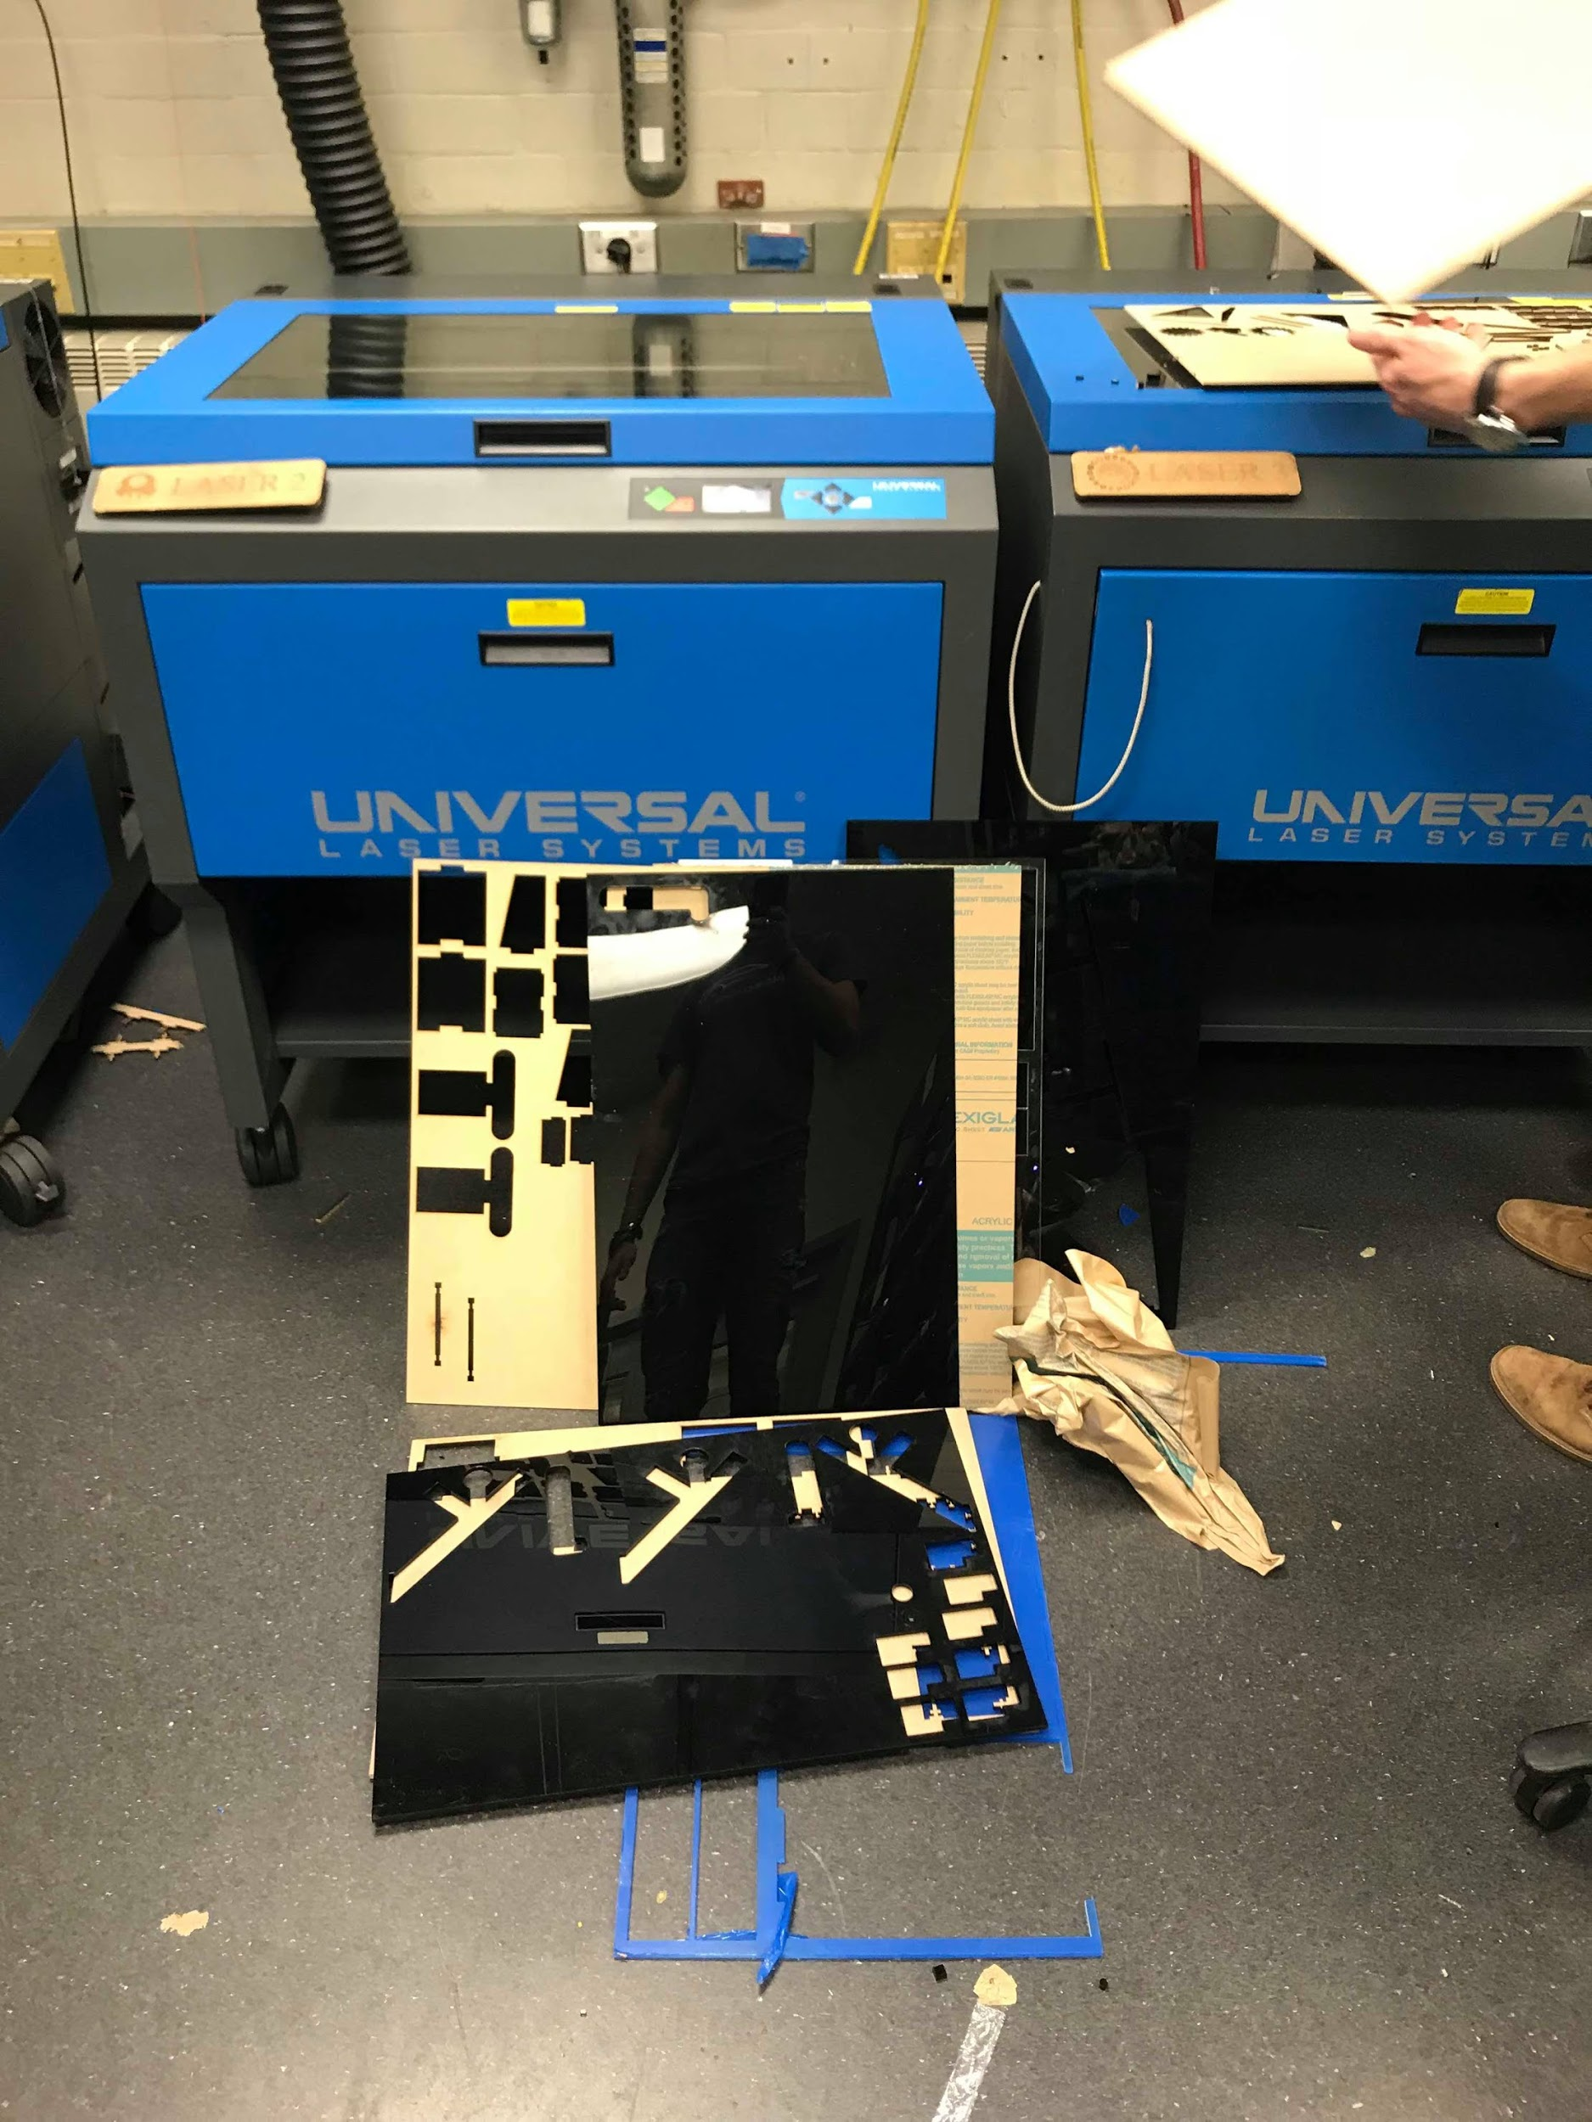
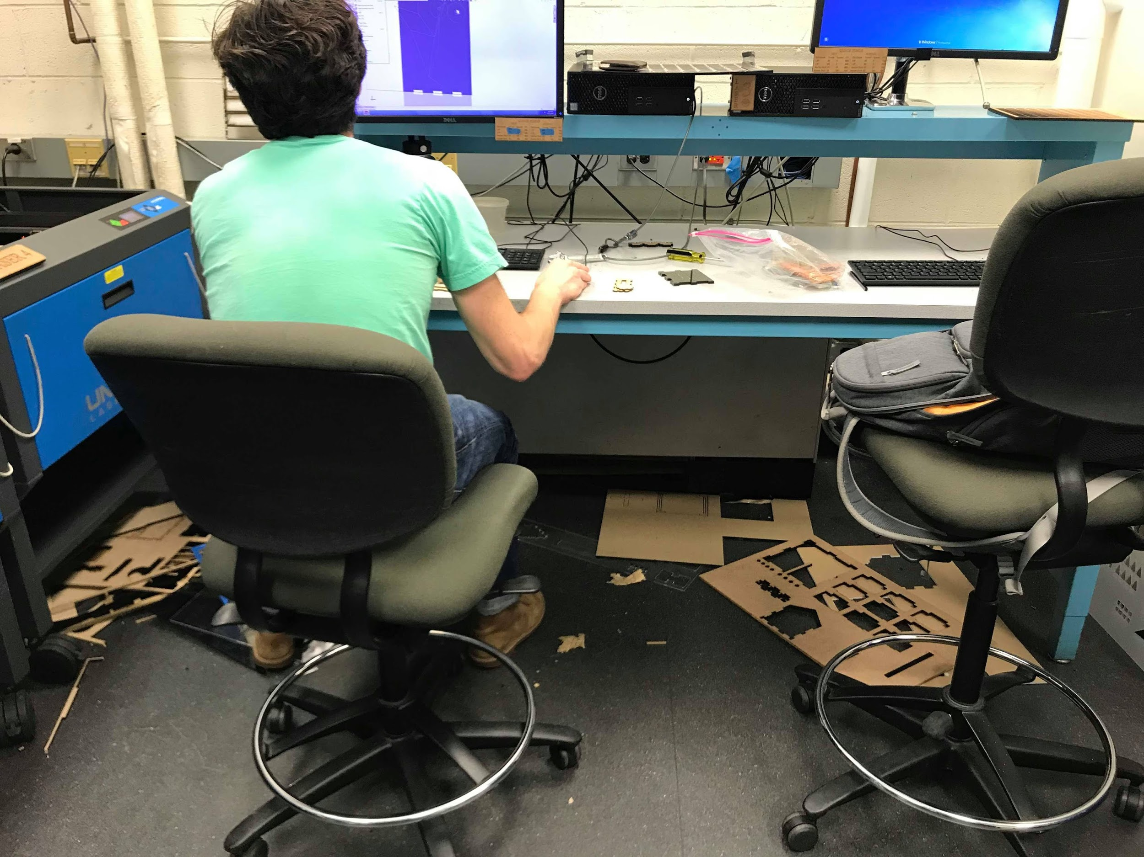
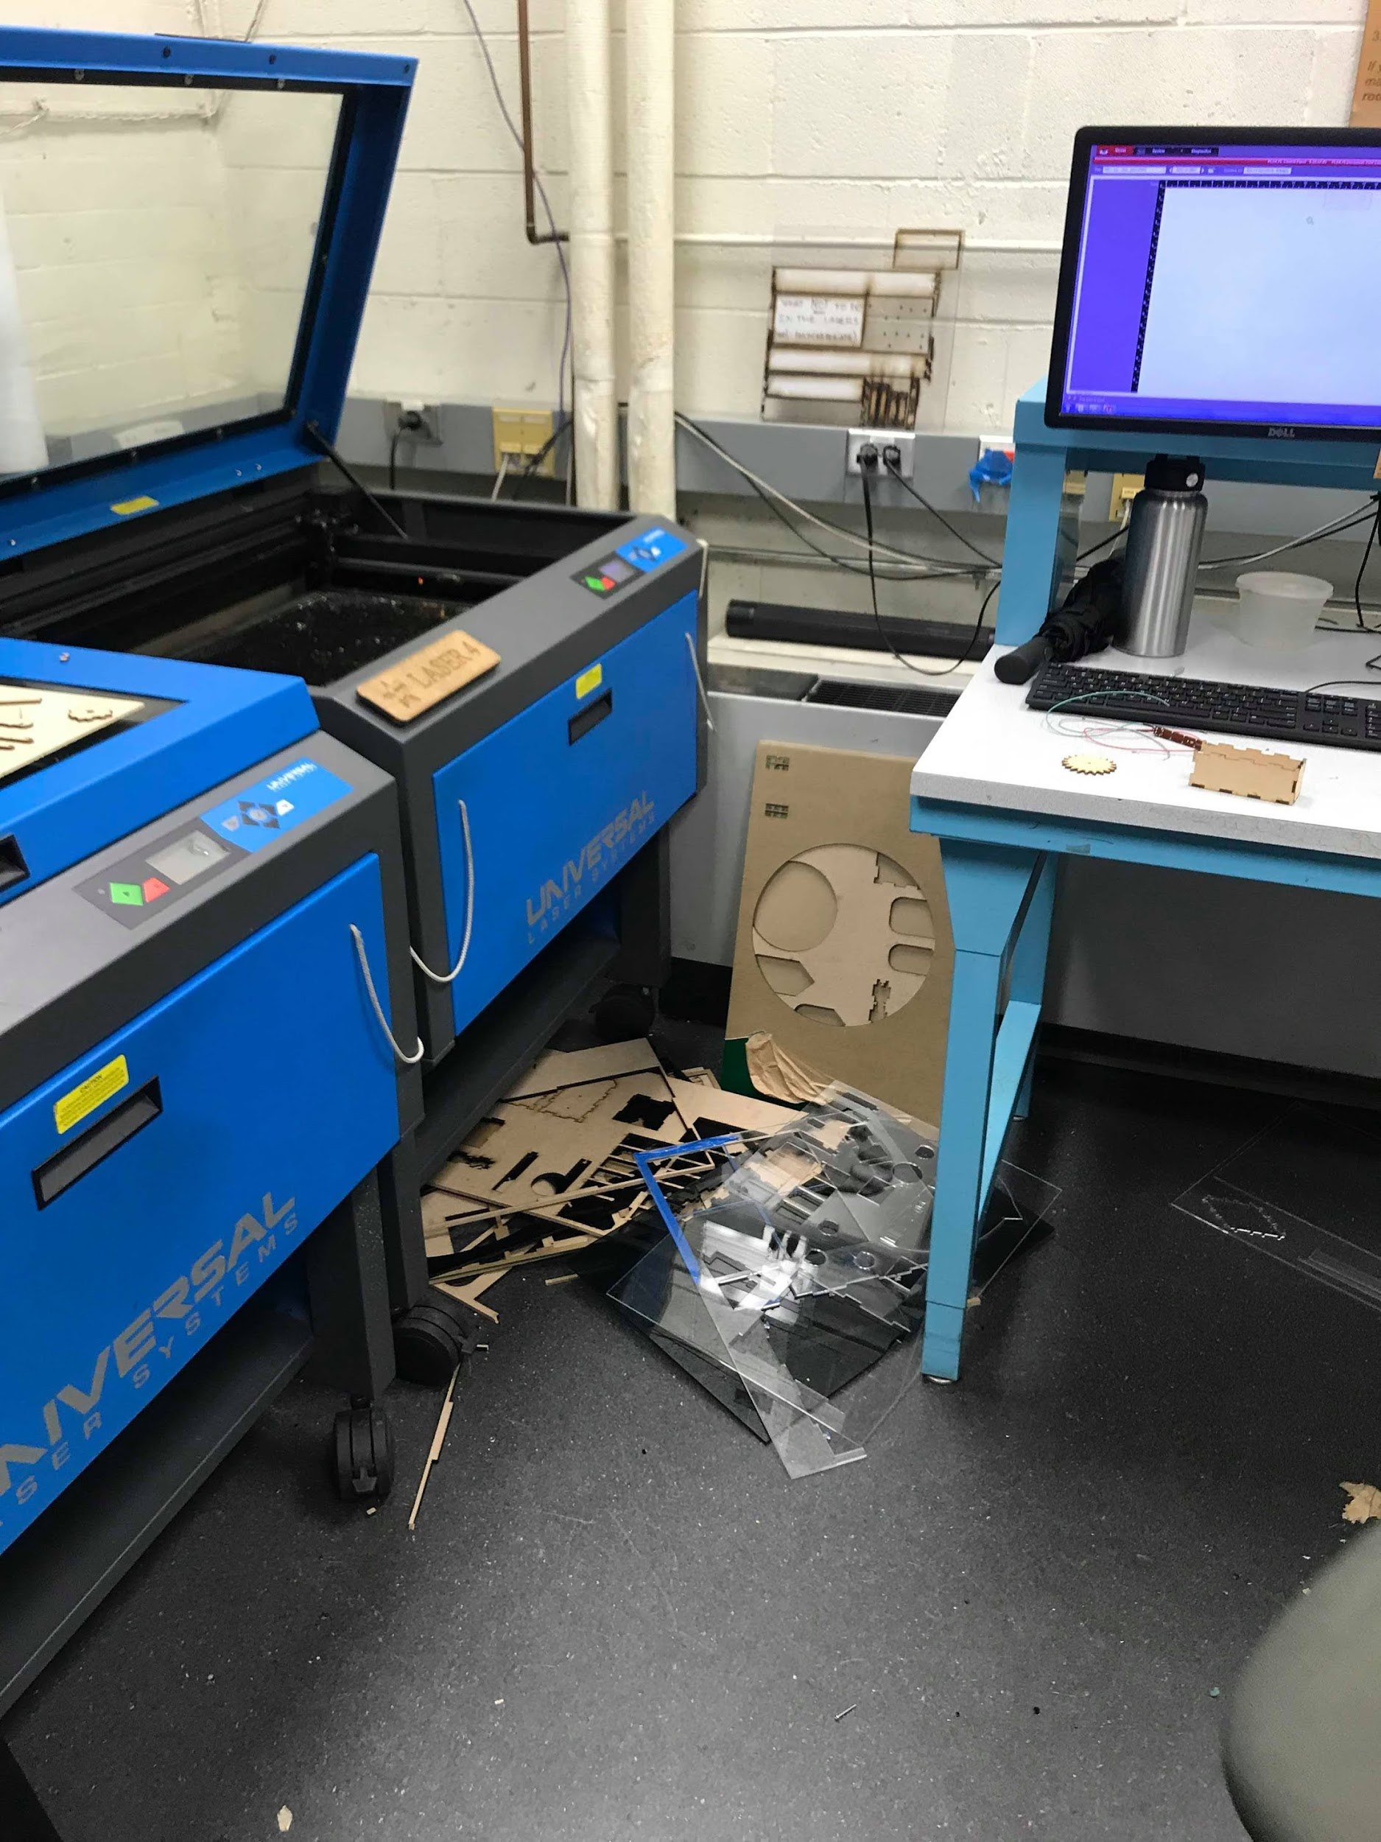
✘DON’T LEAVE MATERIAL BY CUTTERS
Where does it go then?

Slide 15
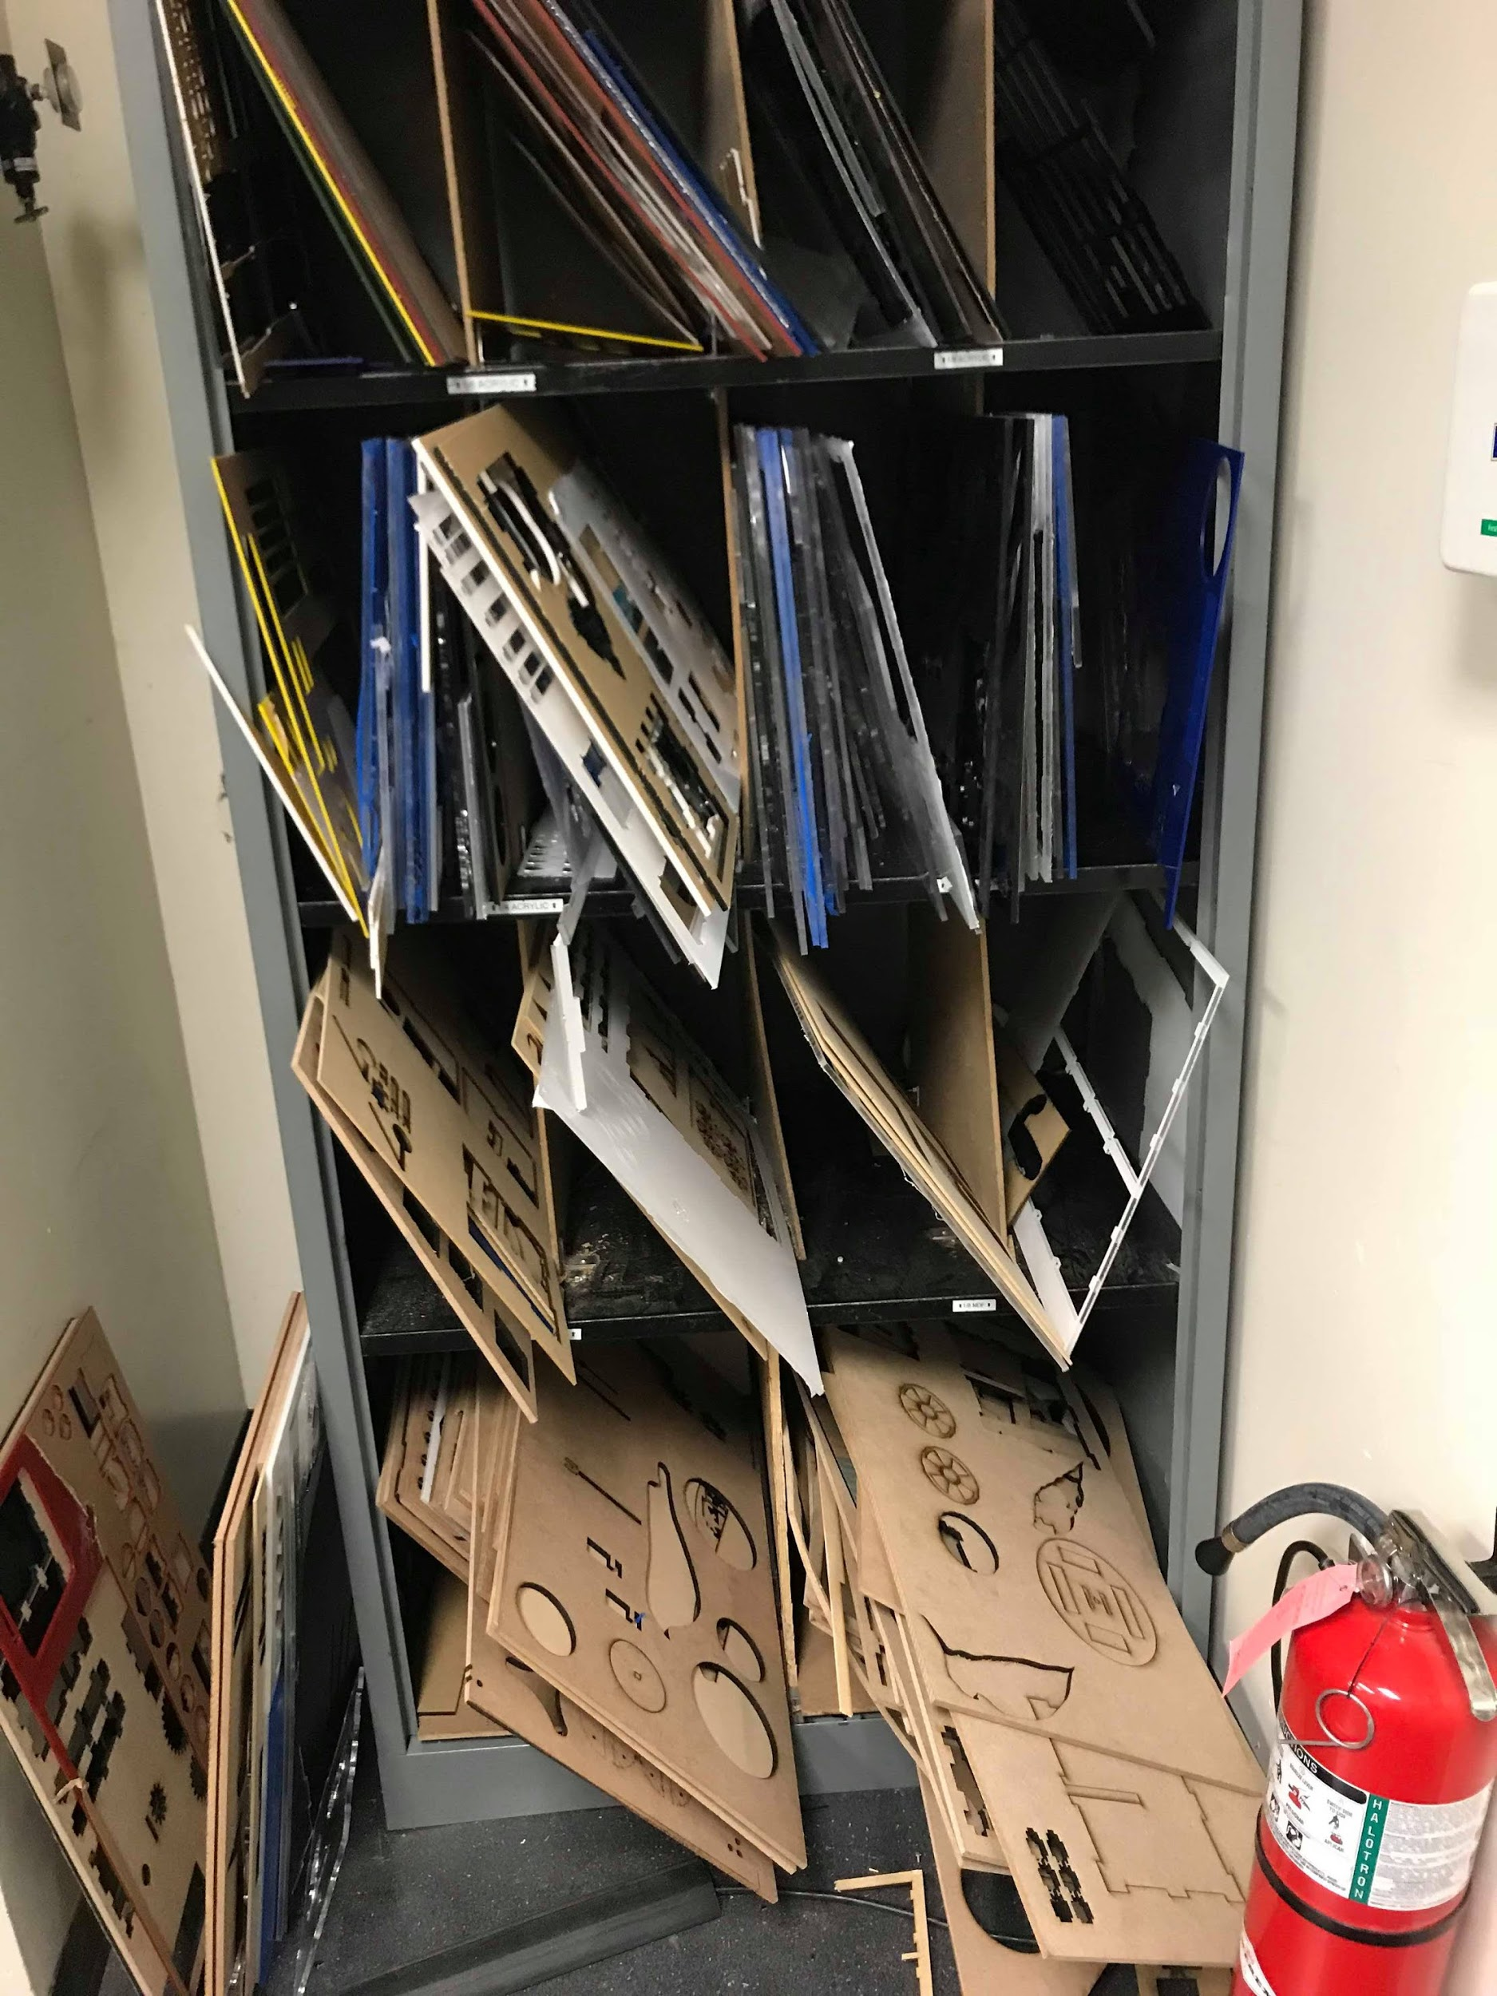
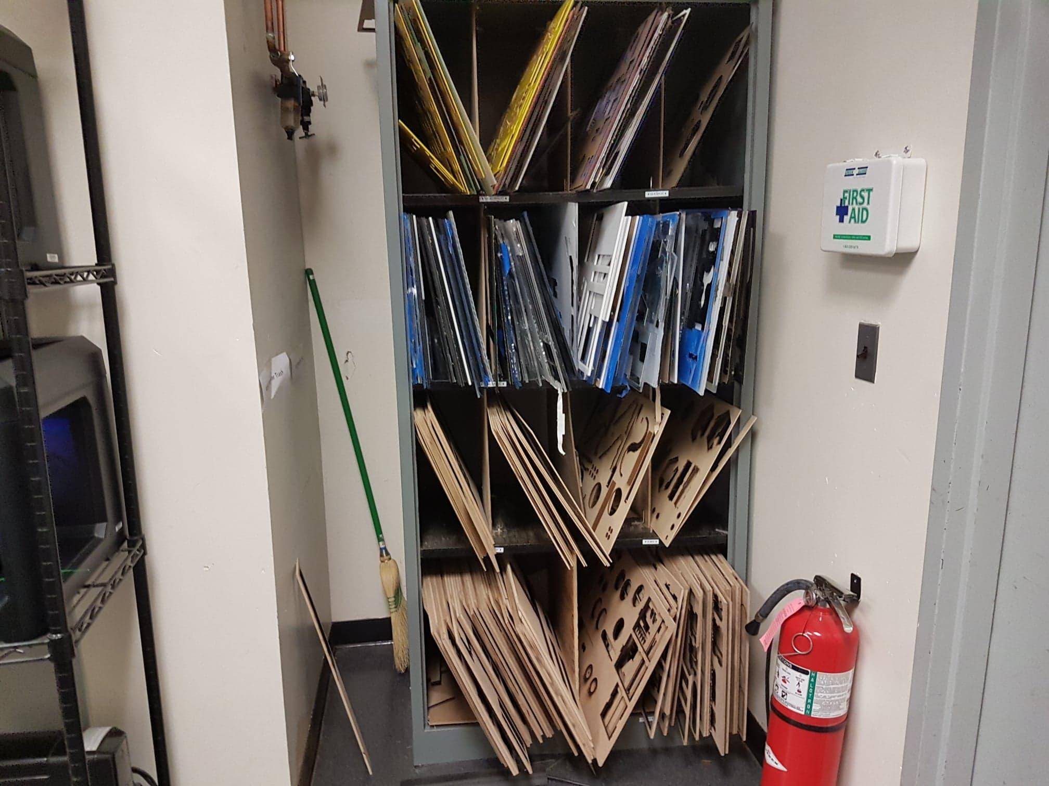
✔RETURN LEFTOVER/USEFUL SHEETS OF MATERIAL TO THE SCRAP SHELF
Material should also be placed neatly in properly labeled shelf
What if my sheet can be trashed?

Slide 16
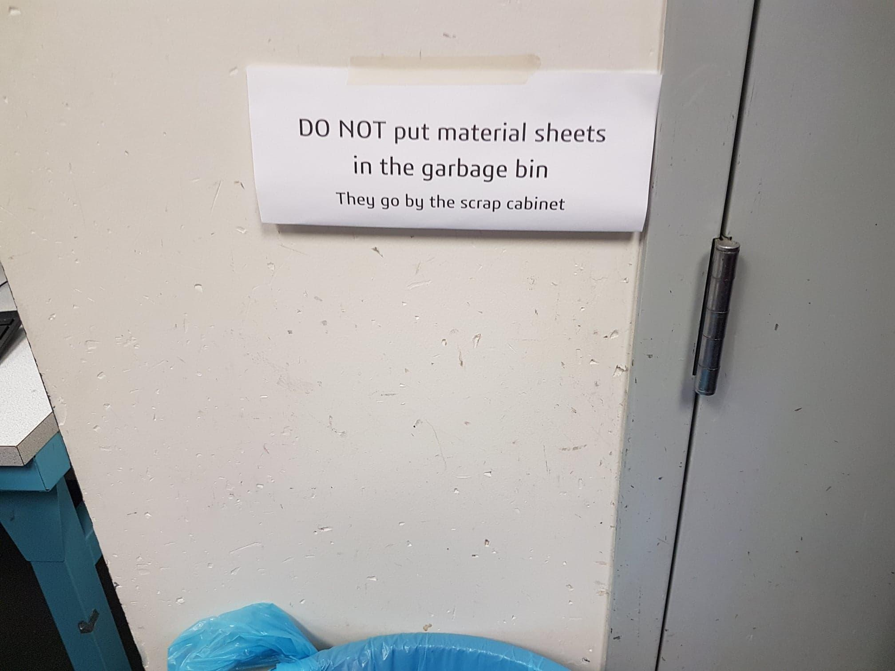
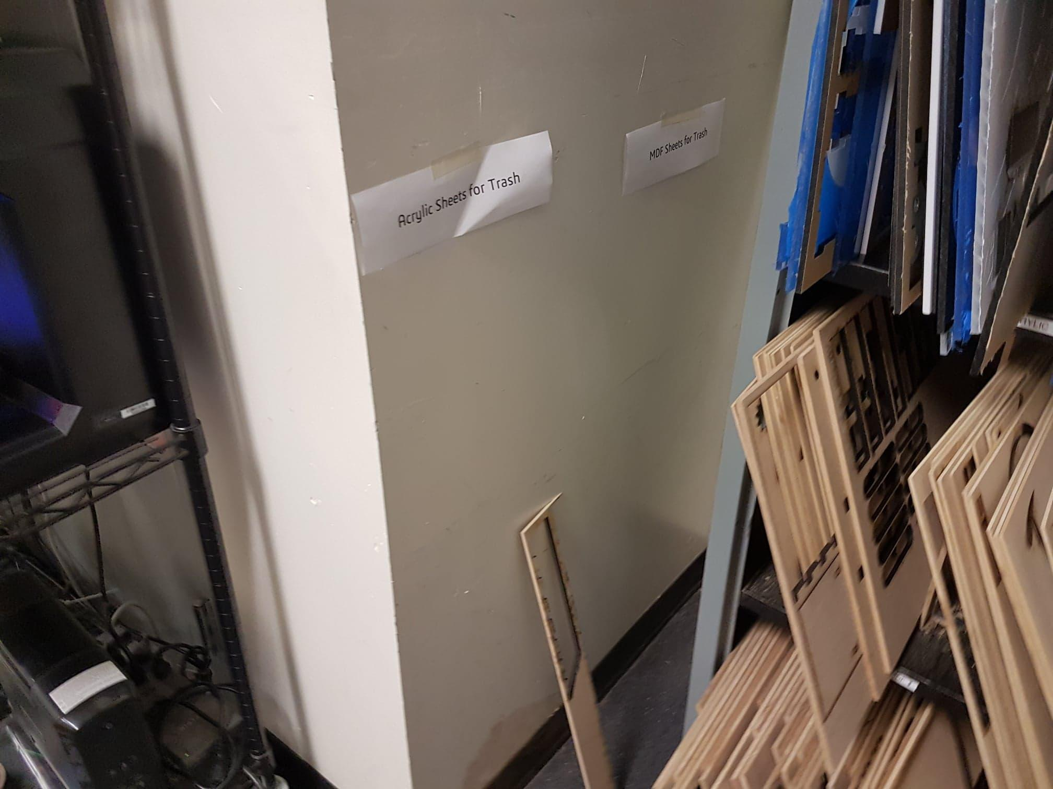
DON’T THROW USED SHEETS IN THE TRASH BIN
^ They go here ^

Slide 17
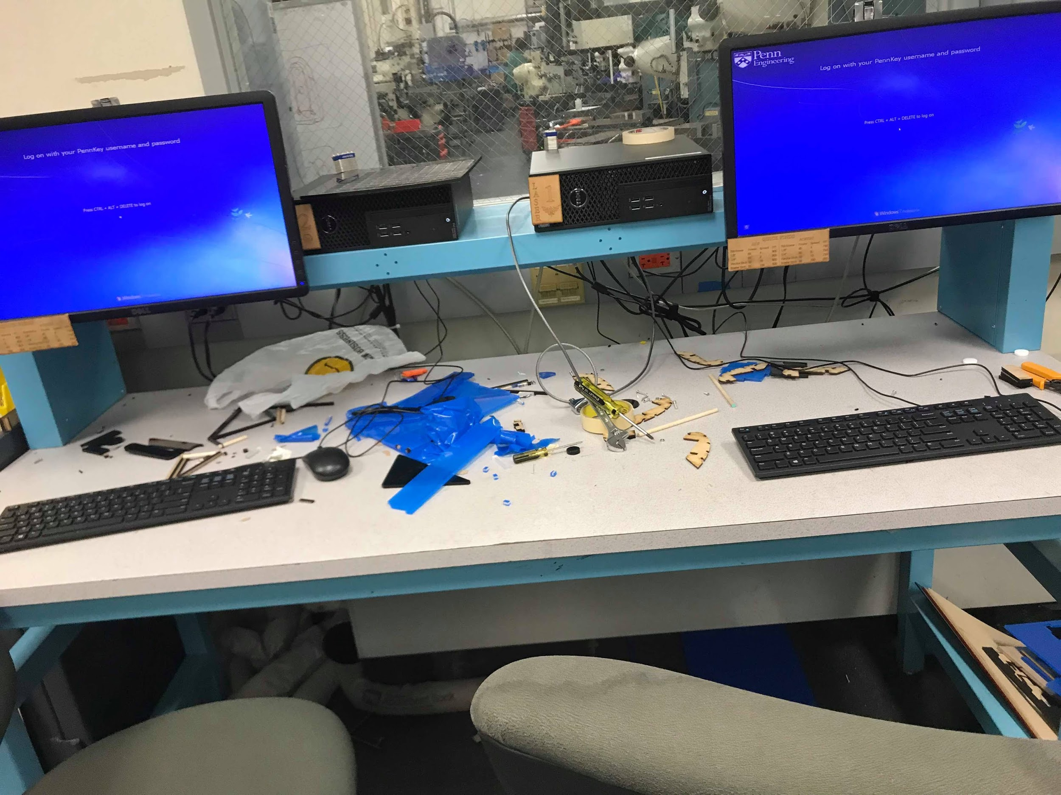
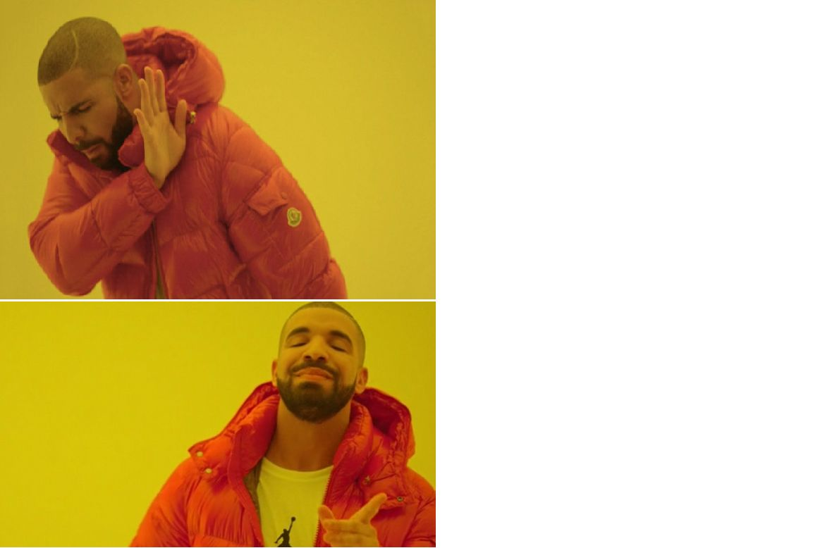
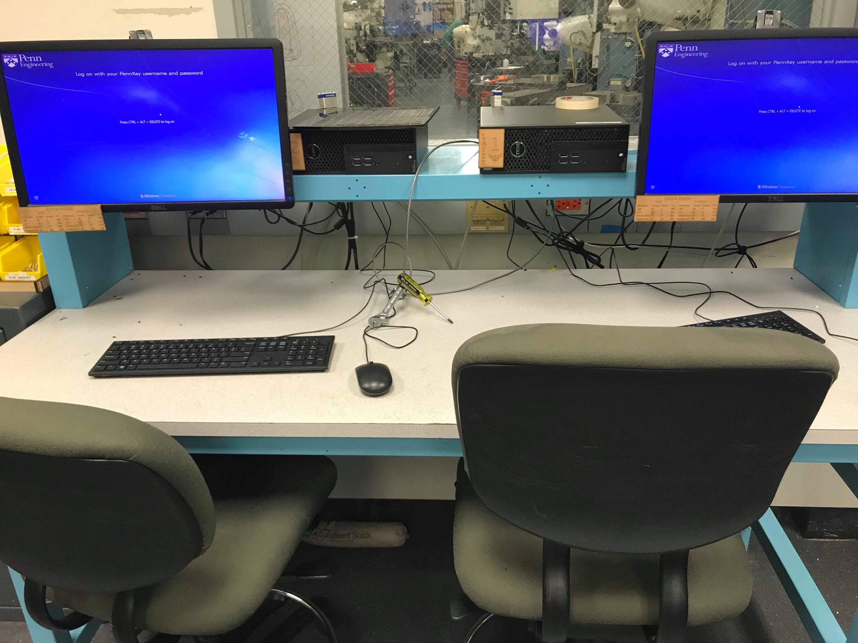
✘ DON’T LEAVE YOUR AREA MESSY
ANY SMALL SCRAPS OR DISCARDED PARTS BELONG IN THE TRASH, NOT ON THE DESKS

Slide 18
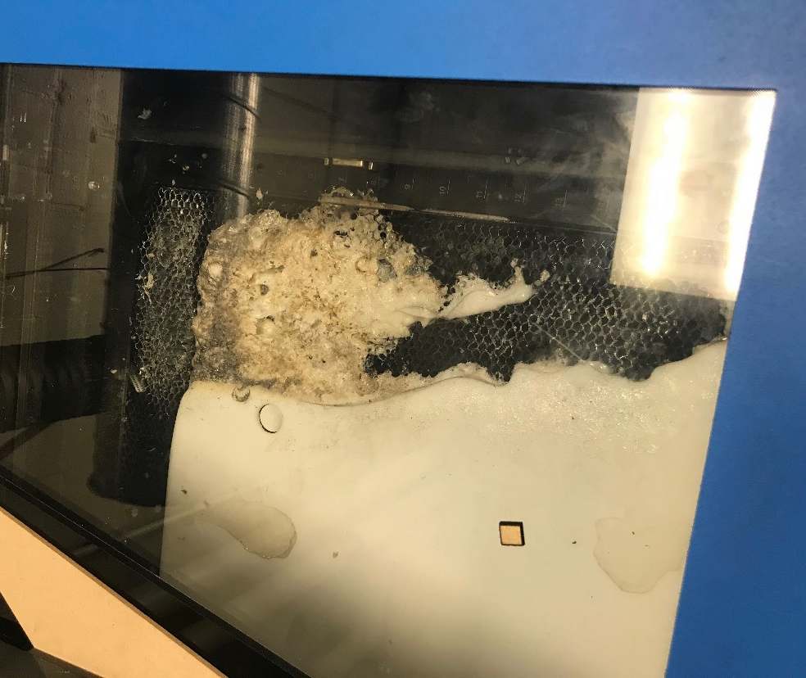
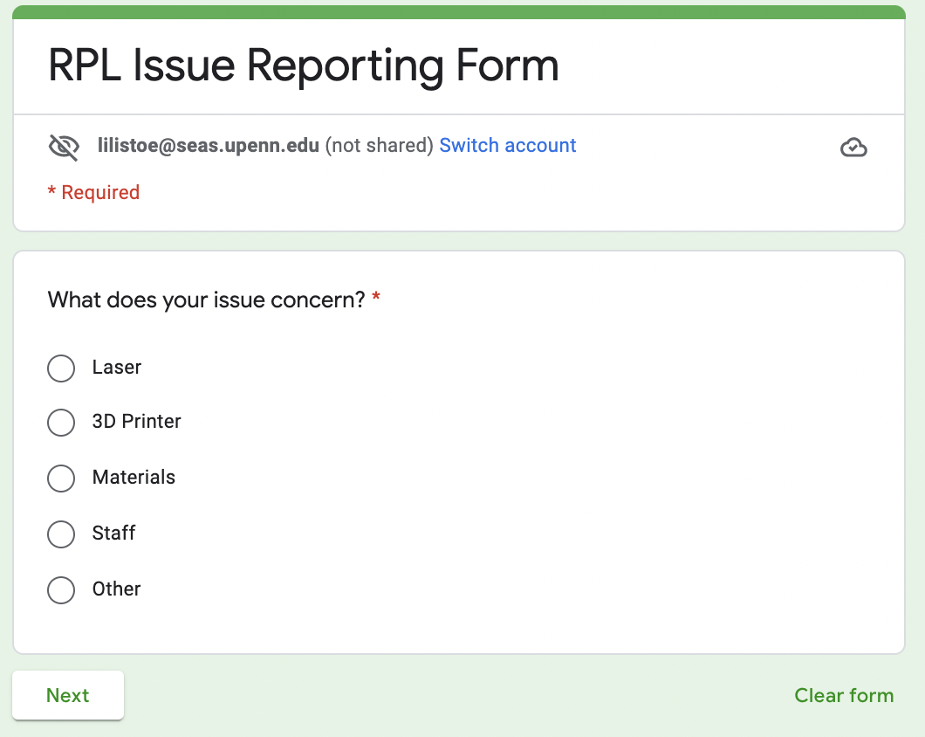
REPORT PROBLEMS YOU MAKE OR FIND!
https://docs.google.com/forms/d/e/1FAIpQLSfppSudtLcfvg9Kvgd08yOAuiDLqAnOB0GUfiIk2abgAPKN4Q/viewform

Slide 19
Lab 2 Questions/Issues?

Slide 20
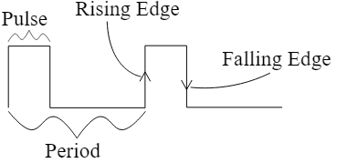
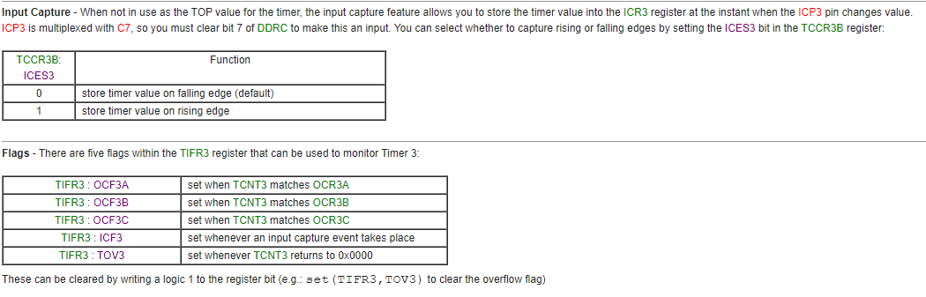
Input Capture
https://learn.digilentinc.com/Documents/chipKIT/P14/PWM.svg
http://medesign.seas.upenn.edu/index.php/Guides/MaEvArM-timer3
Notes:
Lecture 5 - Slide 34, switch pulls signal LOW

Slide 21
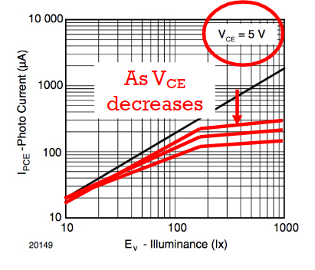
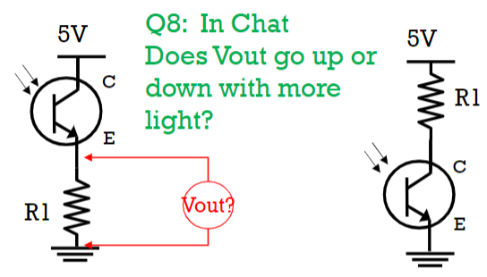
Phototransistor Circuitry
L05 - pg 49-50

Slide 22
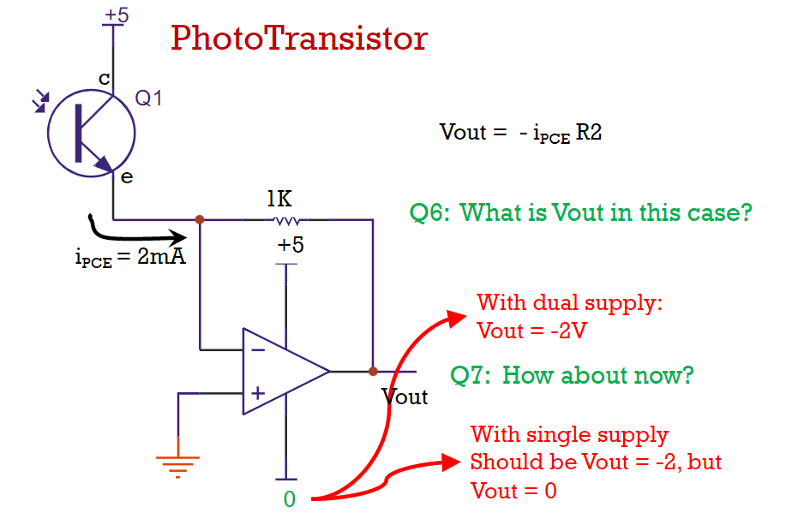
Phototransistors & Op-Amps
L06 - pg 28

Slide 23
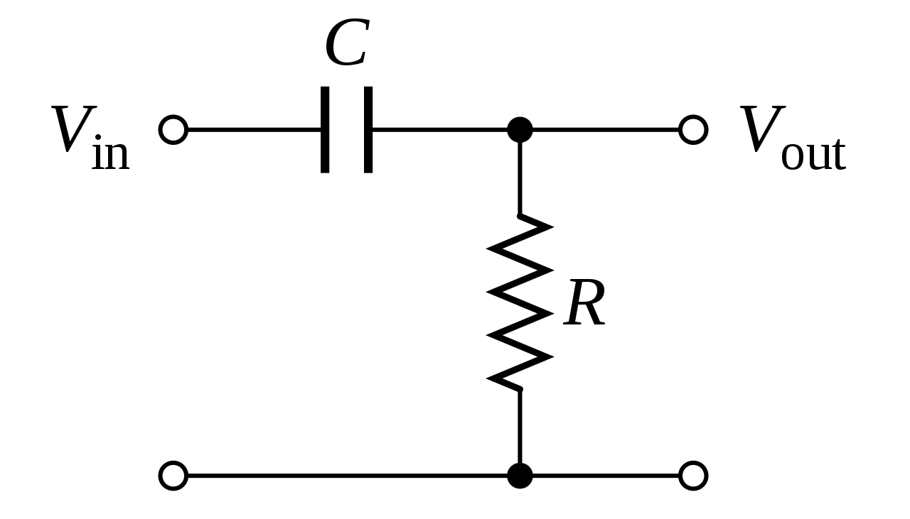
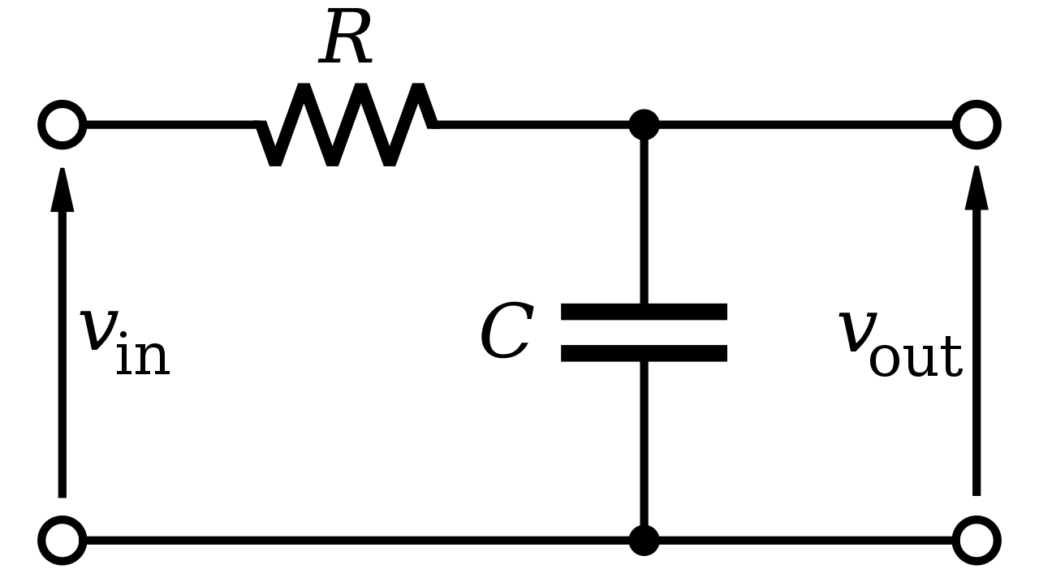
Hardware Filtering
High Pass Filter
Low Pass Filter
Images from Wikipedia.
Corner Frequency = 1 / (2πRC)

Slide 24
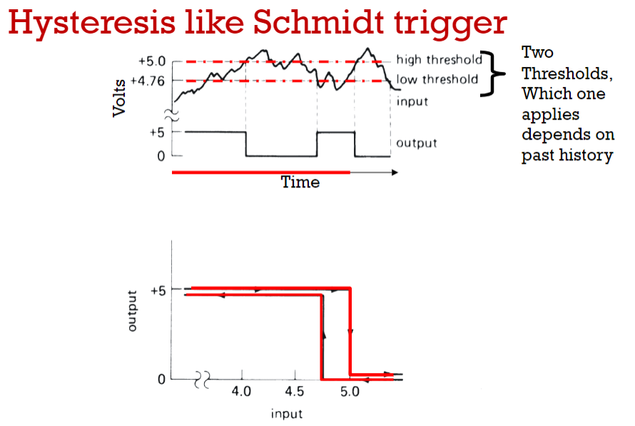
Other questions from Lab 2 / Lectures?
Hysteresis (below from Piazza)
Hysteresis means that the result depends on history. You cannot pick a Vin and say what Vout is without also knowing what Vout was beforehand (since there is feedback).
If you have a given state of Vout (either high or low) then, say if Vin becomes 2V (or whatever you want), you will know whether the ref is above or below 2V and the output will correspond to that condition.

Slide 25
Lab 2 - Due 10/6
Rising v falling edge
Which should we use?
Button circuits and edges
Phototransistors
Set up circuit - talk through what’s happening (where are we measuring on the circuit?)
Using 2.2 for 2.3.2/2.4.1-- does anything need to change between?
Optic Sensing
Oscillosorta - what is it, comfortable using it? MARK COVERING
Pseudocode for detecting 23/700 Hz?
Filtering 60 Hz (hardware filter)
Threshold frequency
Choosing R and C to build filter
Op-Amp Gains
Benefits/problems with very high gains?
How do you tune a gain?

